Slide 1
Getting Started with RAML (Session I)
Using API - Workbench
Alain Lompo
IT Consultant and Developer
RAML MVP

Slide 2
Program
What is RAML?
Why use RAML?
The API Workbench
How to install it
Using API workbench to build raml API
Starting with the Basics
Building your first RAML Api
How to add resources and methods
Adding more details to methods: bodies and responses

Slide 3
Program (II)
Handling sub – resources
Adding examples
Adding types
Handling resource types
Refactoring and extracting resource types
Adding resource type parameters
Handling method parameters
Traits
How to reuse traits, resource type and libraries

Slide 4
What is RAML
RAML stands for Restful Api Modeling Language
Language for describing RESTful API as well as « Practically » RESTful API
You can do the following when using RAML
Design your API
Build it
Test it
Document it
Share it
More information on RAML specs here: https://github.com/raml-org/raml-spec/blob/raml-10/versions/raml-10/raml-10.md

Slide 5
Why use RAML
Because it rocks
It’s really a great platform to design, built and test api along with other related aspects
RAML promotes reusability, conformity to standards, design patterns and a spec driven design approach.
Mike stowe’s podcast about spec driven design gives great insights about the why of platforms like RAML, Swagger, API BluePrint and the like
http://idratherbewriting.com/2015/10/12/spec-driven-design-podcast-michael-stowe/

Slide 6
API workbench
API workbench is an IDE that allows to manage RAML based apis
With API workbench you can design, build, test, document and share your API
Ease your life as far managing API lifecycle (from design to sharing) is concerned
API workbench comes as an Atom plugin.

Slide 7
How to install it
Since it comes as an Atom plugin the simplest way (in my opinion) is to search for « api-workbench » package and install it from the Settinggs → Install packages atom menu item
Another way is to use Atom packages manager command from the console
apm install api-workbench
To check your install: look under Preferences → Packages: you should see api-workbench there.

Slide 8
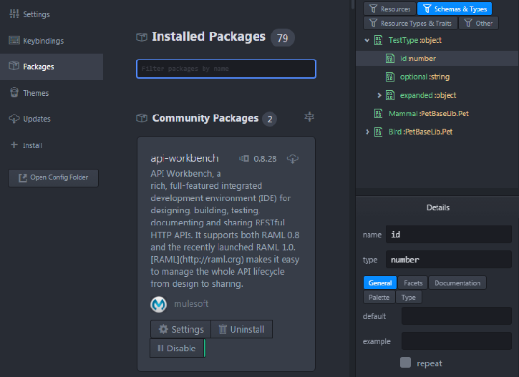

Slide 9
Using API workbench to build raml API
First let’s define a work folder
➔ Go to File → Add project folder to select a work folder
Now every raml file that you create will be saved into the selected working folder.

Slide 10
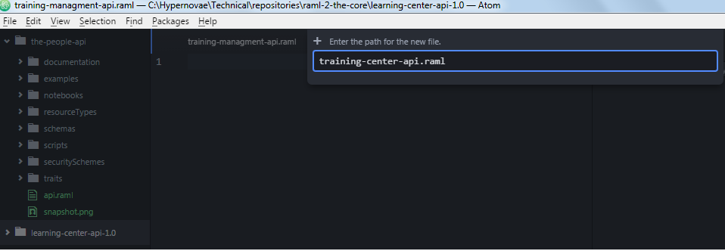
The result….
The working folder is here

Slide 11
Create your first api file
It can be done simply by right clicking on the working folder and chose « New file »
A raml file contains a head line that looks like:
#%RAML 1.0
Api – workbench provides a lot of helpers to reduce the amount of code you need to type to get going

Slide 12
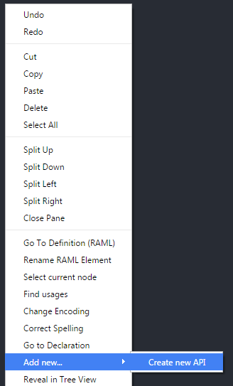
A first nice shortcut
To start with a simply filled .raml file template just
Add a new file as we have seen previously
Right - Click on an empty space inside the editor and choose Add New → Create New Api

Slide 13
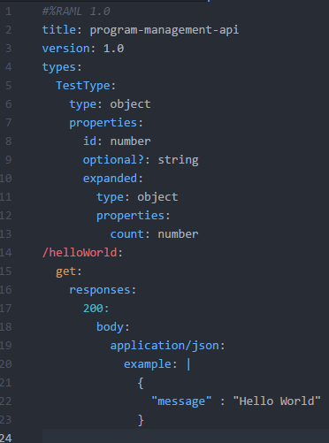
And the result…
All this with just one command….Awesome!!!

Slide 14
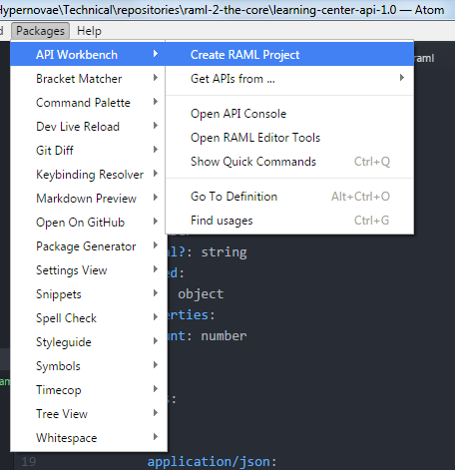
An even simpler approach to create your API
Simply use Packages → API Workbench → Create RAML project

Slide 15
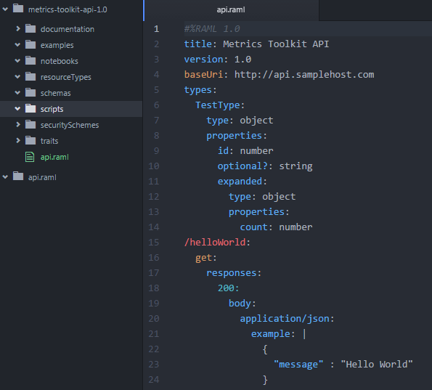
The result…. ( 0 typed line of code)

Slide 16
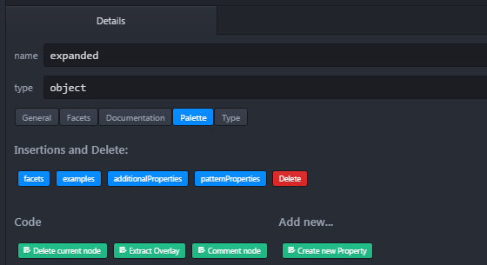
How to add resources and methods
Now that we have the basic shape of the raml api file
Let’s add resources and methods
We can still do much without coding….
By using the actions that are present behind the Palette tab of the Details pane:
The content of that tab changes contextually

Slide 17
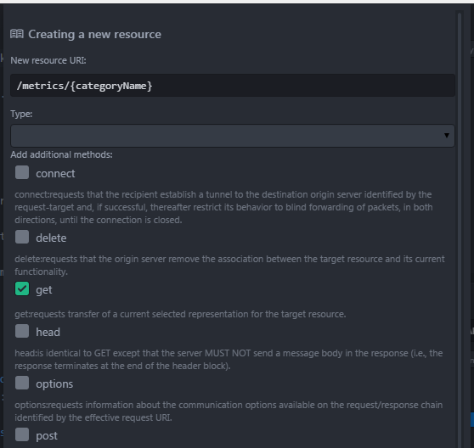
How to add new resource and method
The Add new conextual menu has a sub – menu « Add new resouce »

Slide 18
All classic http verbs are available
Get
Post
Put
Delete
Trace
…

Slide 19
The power of context
Api – workbench makes a smart usage of context update depending on where we are positionned inside the API tree.
For example if we want to add a response to a get action or a body to a post
We position the cursor at the line of the get and post
We use the « Details » pane palette tab to select the appropriate insert.

Slide 20
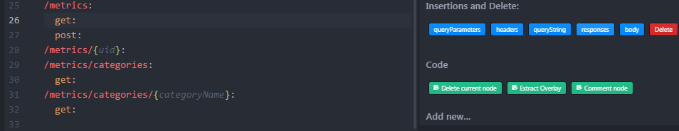
…

Slide 21
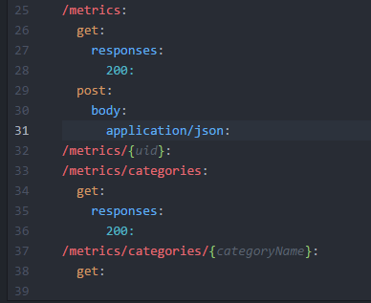
Adding response to get and body to post

Slide 22

Any question?

